Slide 1


Slide 2

Describe some early management examples
Explain the various theories in the classical approach
Discuss the development and uses of the behavioral approach
Describe the quantitative approach
Explain the various theories in the contemporary approach
Copyright © 2012 Pearson Education, Inc. Publishing as Prentice Hall

Slide 3
Historical Background of Management
Ancient Management
  Egypt (pyramids) and China (Great Wall)
Adam Smith The Wealth of Nations in 1776
  Focused on job specialization
Industrial Revolution
  Substituted machine power for human labor
  Created large organizations in need of management
Copyright © 2012 Pearson Education, Inc. Publishing as Prentice Hall

Slide 4
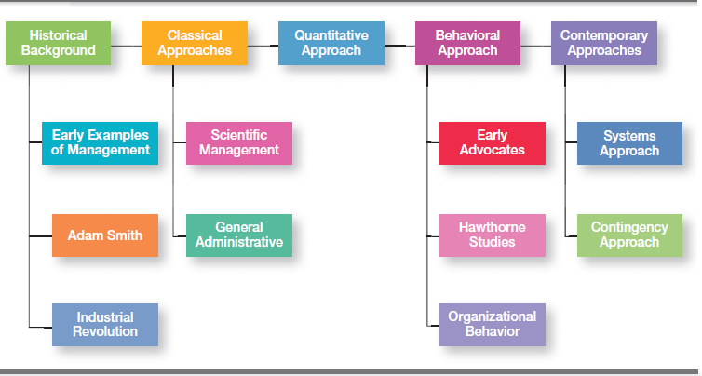
Exhibit MH-1: Major Approaches to Management
Copyright © 2012 Pearson Education, Inc. Publishing as Prentice Hall

Slide 5
Scientific Management
Fredrick Winslow Taylor
  The “father” of scientific management
The theory of scientific management
  Using scientific methods to define the “one best way” for a job to be done:
    Putting the right person on the job with the correct tools and equipment
    Having a standardized method of doing the job
    Providing an economic incentive to the worker
Copyright © 2012 Pearson Education, Inc. Publishing as Prentice Hall

Slide 6
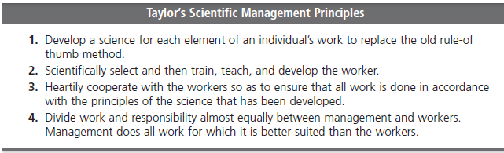
Exhibit MH-2
Copyright © 2012 Pearson Education, Inc. Publishing as Prentice Hall

Slide 7
General Administrative Theory
Henri Fayol
  Believed that the practice of management was distinct from other organizational functions
  Developed principles of management that applied to all organizational situations
Max Weber
  Developed a theory of authority based on an ideal type of organization (bureaucracy)
    Emphasized rationality, predictability, impersonality, technical competence, and authoritarianism
Copyright © 2012 Pearson Education, Inc. Publishing as Prentice Hall

Slide 8
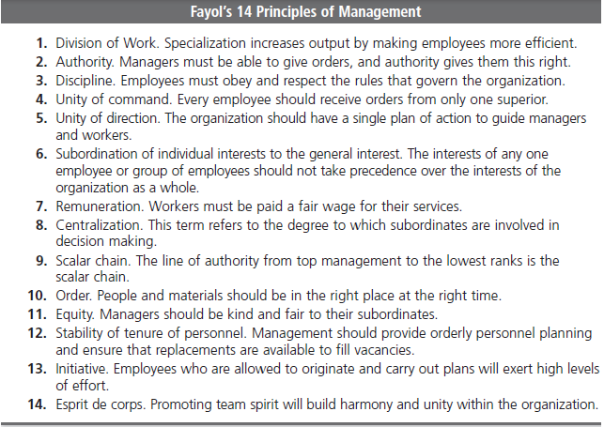
Exhibit MH-3
Copyright © 2012 Pearson Education, Inc. Publishing as Prentice Hall

Slide 9
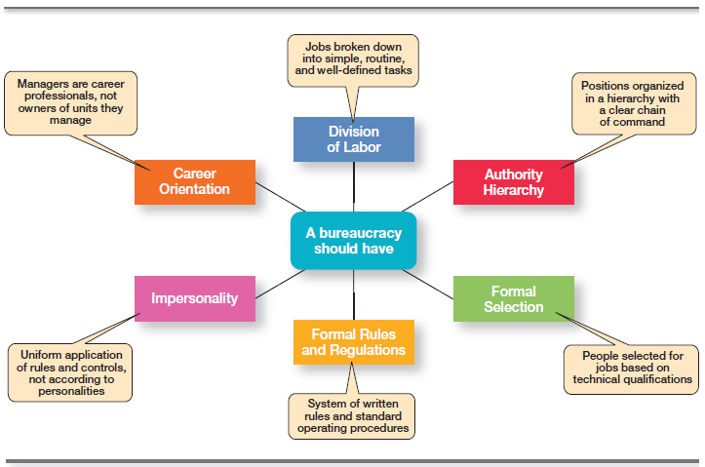
Exhibit MH-4
Copyright © 2012 Pearson Education, Inc. Publishing as Prentice Hall

Slide 10
Quantitative Approach
Quantitative Approach
  Also called operations research or management science
  Evolved from mathematical and statistical methods developed to solve WWII military logistics and quality control problems
  Focuses on improving managerial decision making by applying:
    Statistics, optimization models, information models, and computer simulations
Copyright © 2012 Pearson Education, Inc. Publishing as Prentice Hall

Slide 11
Organizational Behavior
Organizational Behavior (OB)
  The study of the actions of people at work; people are the most important asset of an organization
Early OB Advocates
  Robert Owen
  Hugo Munsterberg
  Mary Parker Follett
  Chester Barnard
Copyright © 2012 Pearson Education, Inc. Publishing as Prentice Hall

Slide 12
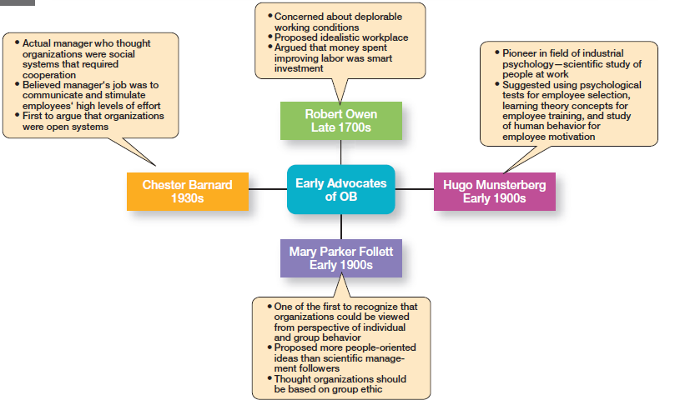
Exhibit MH-5
Copyright © 2012 Pearson Education, Inc. Publishing as Prentice Hall

Slide 13
The Hawthorne Studies
A series of productivity experiments conducted at Western Electric from 1924 to 1932
  Experimental findings
    Productivity unexpectedly increased under imposed adverse working conditions.
    The effect of incentive plans was less than expected.
  Research conclusion
    Social norms, group standards and attitudes more strongly influence individual output and work behavior than do monetary incentives.
Copyright © 2012 Pearson Education, Inc. Publishing as Prentice Hall

Slide 14
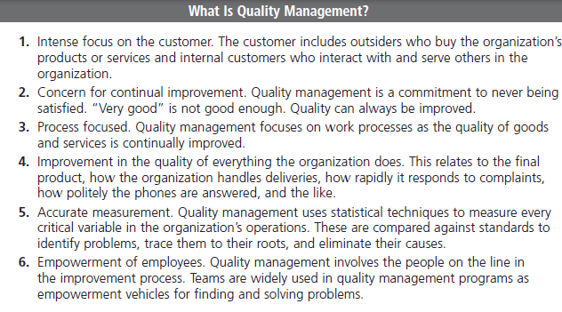
Exhibit MH-6
Copyright © 2012 Pearson Education, Inc. Publishing as Prentice Hall

Slide 15
The Systems Approach
System - a set of interrelated and interdependent parts arranged in a manner that produces a unified whole.
Closed systems
    Are not influenced by and do not interact with their environment (all system input and output is internal)
Open systems
    Dynamically interact to their environments by taking in inputs and transforming them into outputs that are distributed into their environments
Copyright © 2012 Pearson Education, Inc. Publishing as Prentice Hall

Slide 16
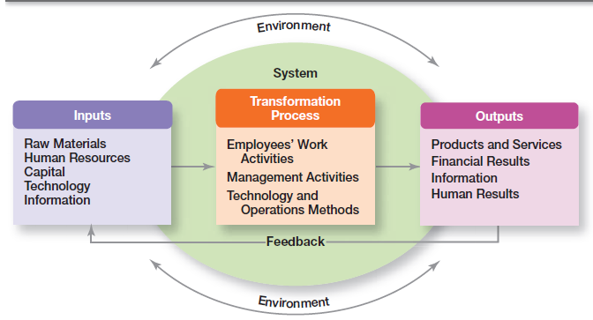
Exhibit MH-7
Copyright © 2012 Pearson Education, Inc. Publishing as Prentice Hall

Slide 17
The Contingency Approach
Contingency Approach - sometimes called the situational approach
  There is no one universally applicable set of management principles (rules) by which to manage organizations.
  Organizations are individually different, face different situations (contingency variables), and require different ways of managing.
Copyright © 2012 Pearson Education, Inc. Publishing as Prentice Hall

Slide 18
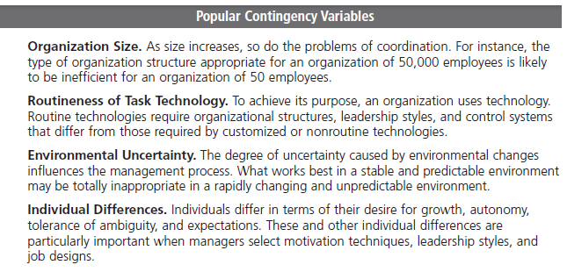
Exhibit MH-8
Copyright © 2012 Pearson Education, Inc. Publishing as Prentice Hall

Slide 19
Terms to Know
division of labor (or job specialization)
Industrial Revolution
scientific management
therbligs
general administrative theory
principles of management
bureaucracy
quantitative approach
organizational behavior (OB)
Hawthorne Studies
system
closed systems
open systems
contingency approach
Copyright © 2012 Pearson Education, Inc. Publishing as Prentice Hall

Slide 20
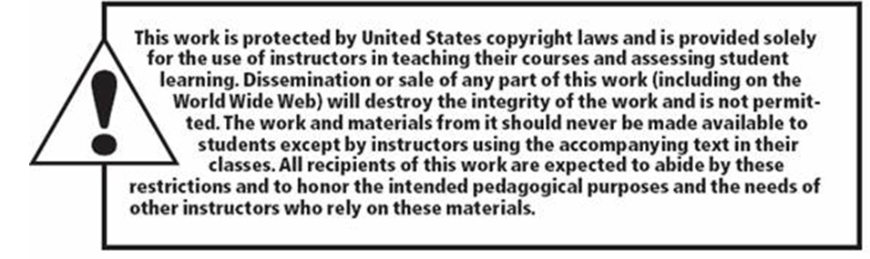
Copyright © 2012 Pearson Education, Inc. Publishing as Prentice Hall

